Slide 1
Airbnb NYC Analysis

Slide 2
Introduction
The Project is based on Online Marketplace for lodging, Primarily homestays for vacation rentals, and Tourism activities
Guests and hosts have used Airbnb to expand on traveling possibilities and present a more unique, personalized way of experiencing the world. Nowadays, Airbnb became one of a kind service that is used by the whole world. Data analysts become a crucial factor for the company that provided millions of listings through Airbnb. These listings generate a lot of data that can be analyzed and used for security, business decisions, understanding of customers’ and providers’ behavior on the platform, implementing innovative additional services, guiding marketing initiatives, and much more.
As per the dataset got some insights for better understanding
This Dataset consist of 16 columns and 26146 rows after data cleaning
From this dataset, the fields which are used as follows :-
Id, name, host_id, host_name, neighbourhood_group, neighbourhood, latitude, longitude, room_type, price, minimum_nights, number_of_reviews, last_review, reviews_per_month, calculated_host_listings_count, availability_365

Slide 3
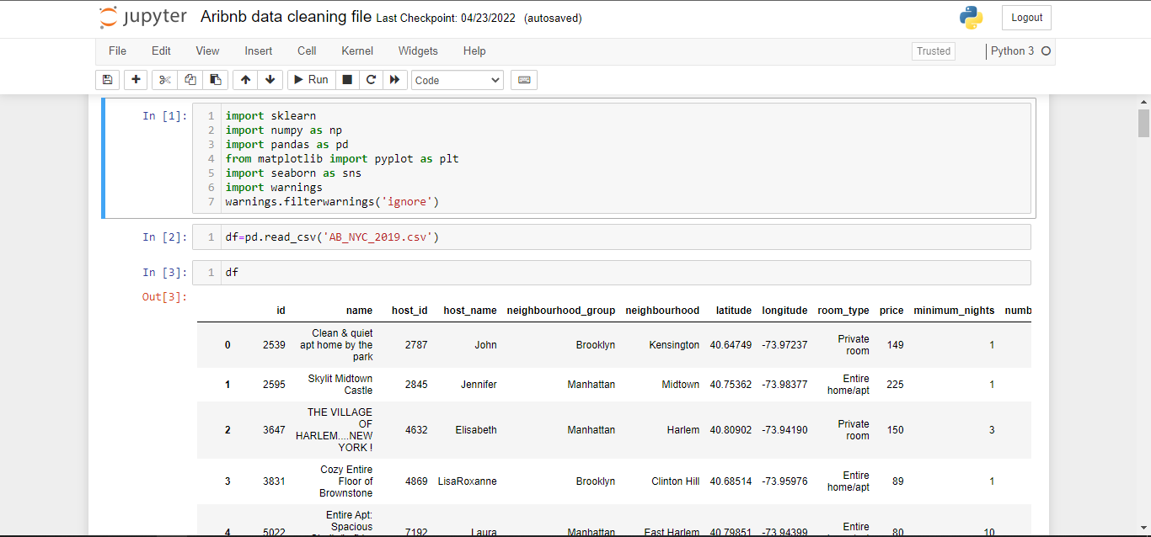
Data Cleaning
Used Python for data cleaning :- Imported Some libraies.
Data got in CSV format, so to taking that csv file in python used one of library of python Pandas to create the DataFrame

Slide 4
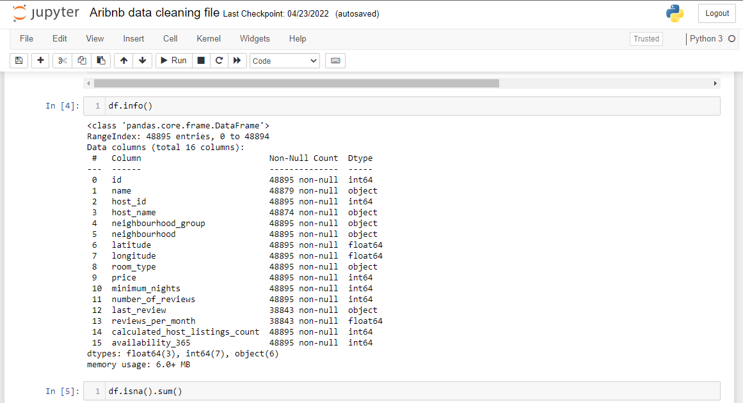
In this slide I just checking Data type of every columns

Slide 5
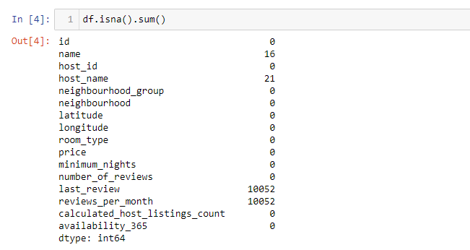
When we look at data there is lots of null values present in our data

Slide 6
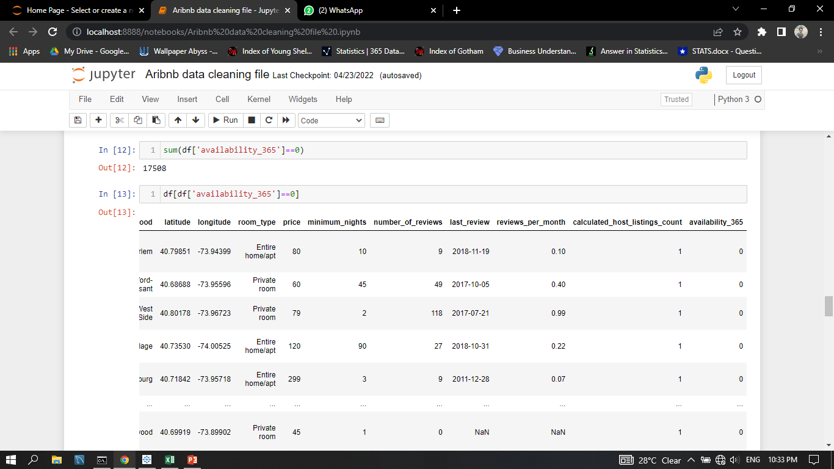
In our data there is one Important feature, name is availability_365 this column is such important for Airbnb business because if the room is not available then its not helping to growing Airbnb business, so here I have found that the 0 value which are present in the availability_365 and here we just dropped that records

Slide 7
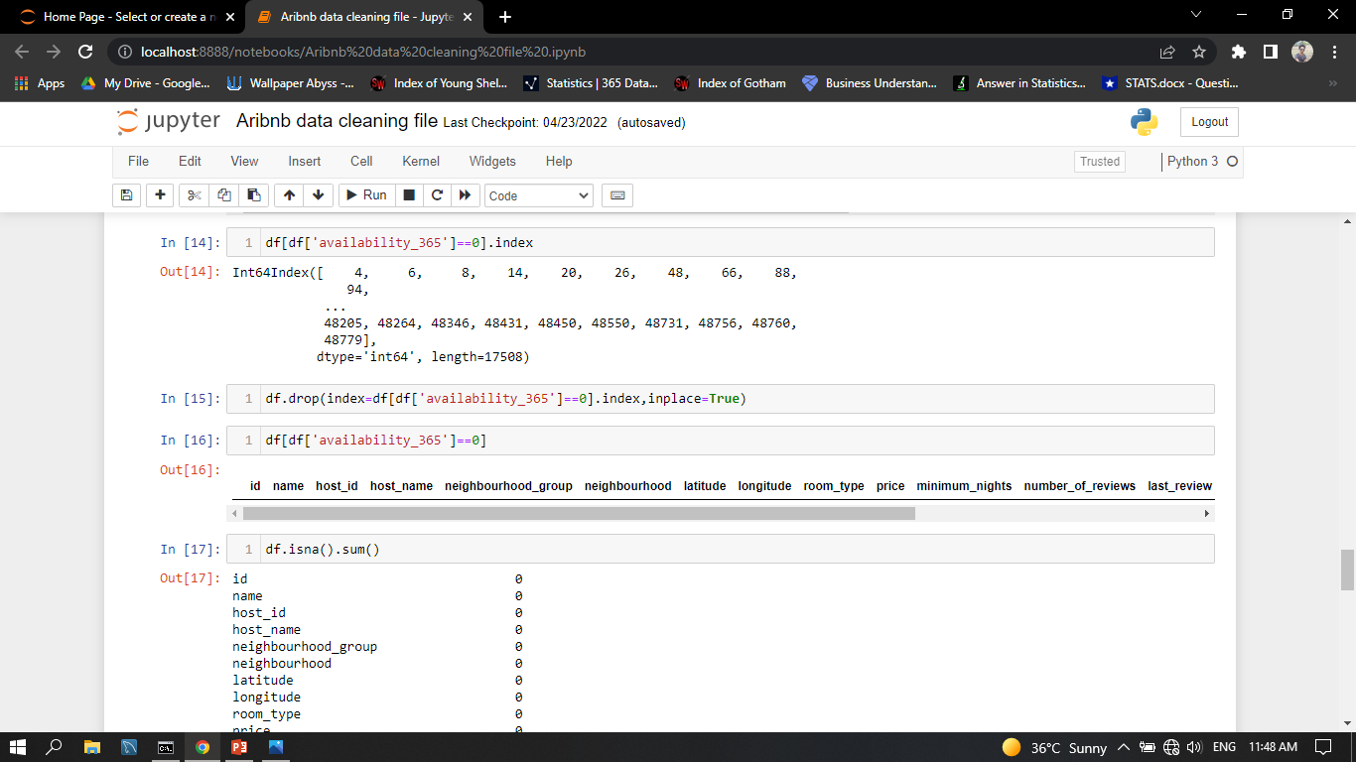
Here using this code we dropped that records which have 0 values in availability_365

Slide 8
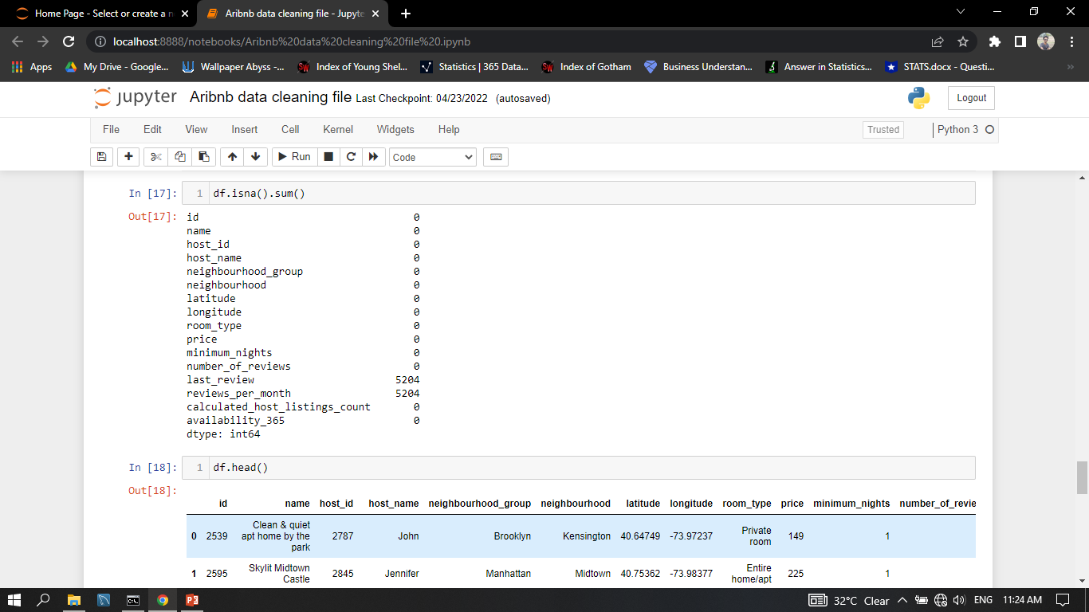
After dropped some records we can see that last_reviews, reviews_per_months still have null values basically that values are blanks there is no values presents, so this records we dropped

Slide 9
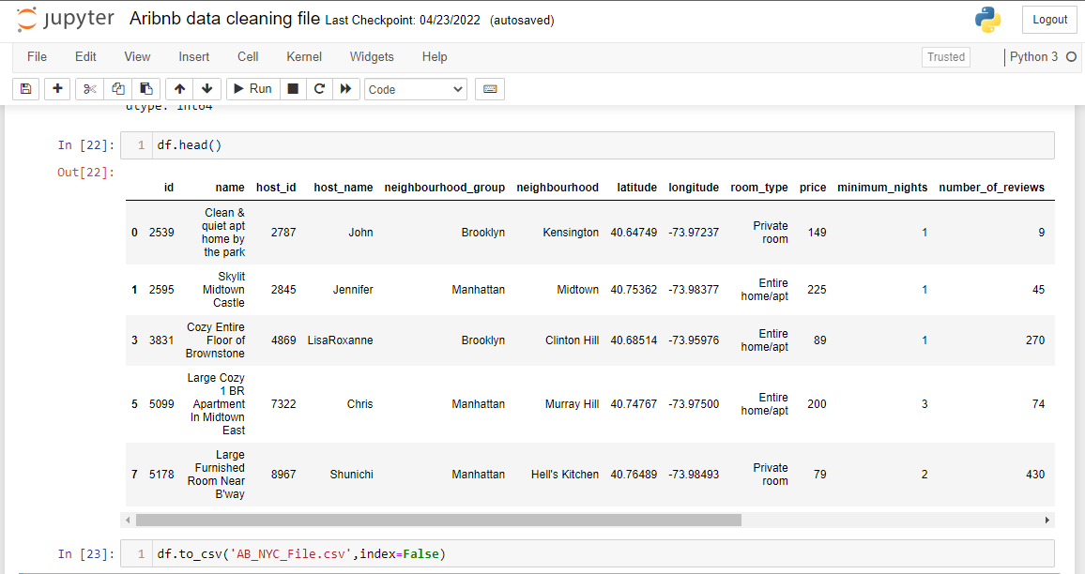
After the whole data cleaning finally here I just created CSV file and imported CSV file in Tableau for analysis and visualization

Slide 10
Research Questions
Regarding Property
Which Neighbourhood_Group has highest Properties?
Top N Property holder in each Neighbourhood?
Popular Neighbouhood For Staying
Top N Most Expensive Property
Regarding Room Type
Total Count of Room Type in each Neighbourhood_Group?
Which Neighbourhood has the maximum nights availability?
Most Expensive Room type?
Most Popular Room Type?
Regarding Price and Earning
What is relation between Price and Earning?
Earning and their relation with availability in different neighbourhood groups
Top 10 Host who has most Earning?
Which Year has Highest Earning?
Avg.Price of Neighbourhood
Regarding Reviews
Total Reviews per Neighbourhood_Group?
Highest Reviews Month Wise?
Top N host name who got highest reviews

Slide 11
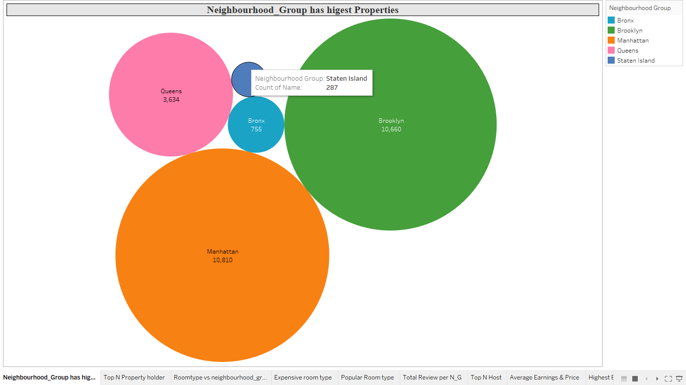
Regarding Property
Which Neighbourhood_Group has highest Properties :-
Chart Shows distribution of property Neighbourhood_Groups,
Manhattan City has the highest properties followed by Brooklyn in New York City

Slide 12
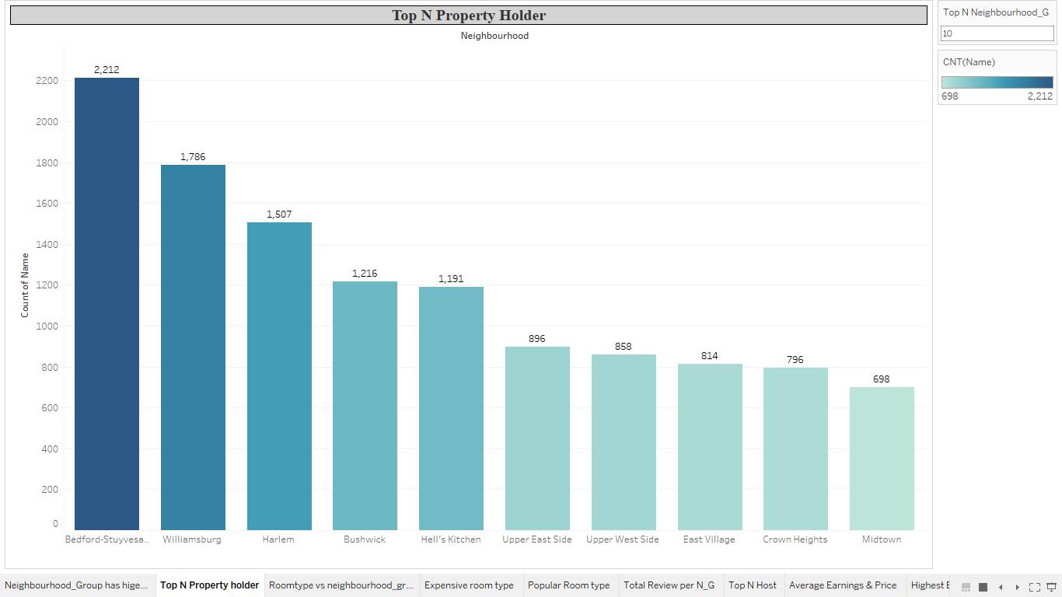
Top N Property holder in each Neighbourhood :- Here we can see the Bedford-Stuyvesant has Highest property Holder which is 2,212 and its in Brooklyn

Slide 13
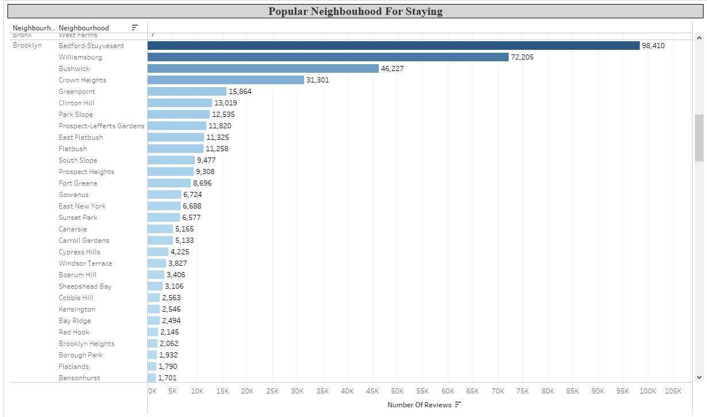
Popular Neighbouhood For Staying :- As data saying People Preferred to stay in Bedford-Stuyvesant

Slide 14
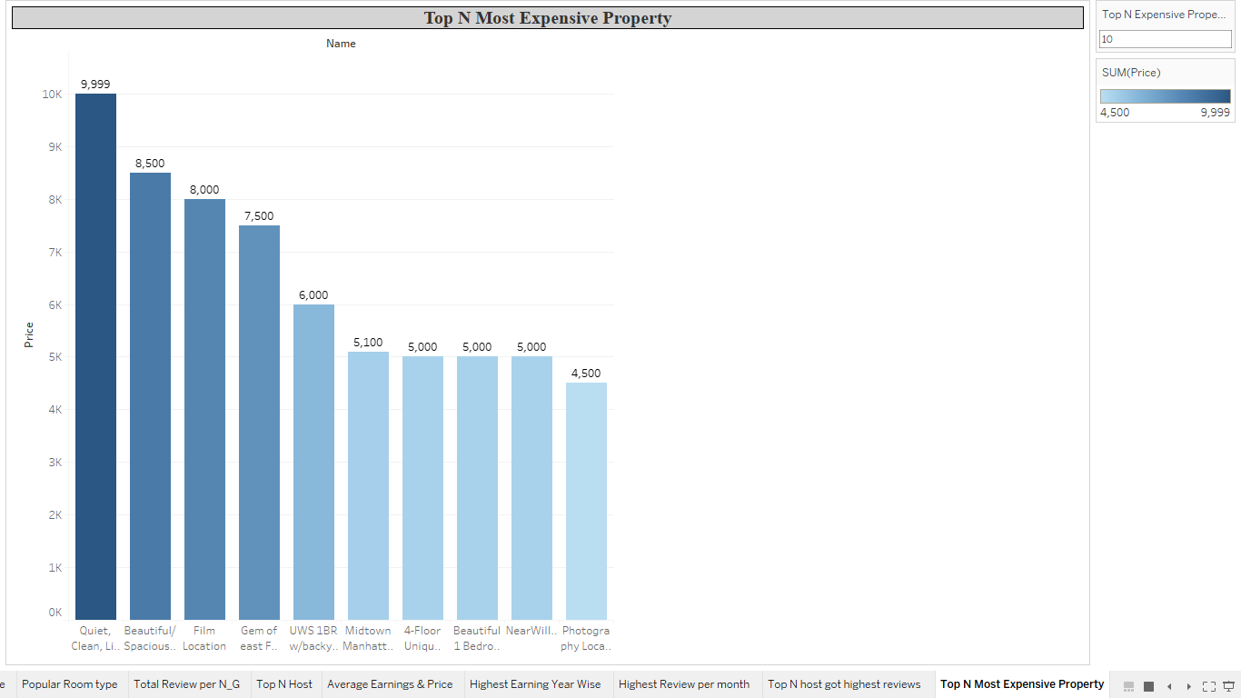
Top N Most Expensive Property :- Quiet, Clean, Lit @ LES & Chinatown is the most expensive property among all the properties, the Price is 9,999$ for a night and this property is located in Manhattan.

Slide 15
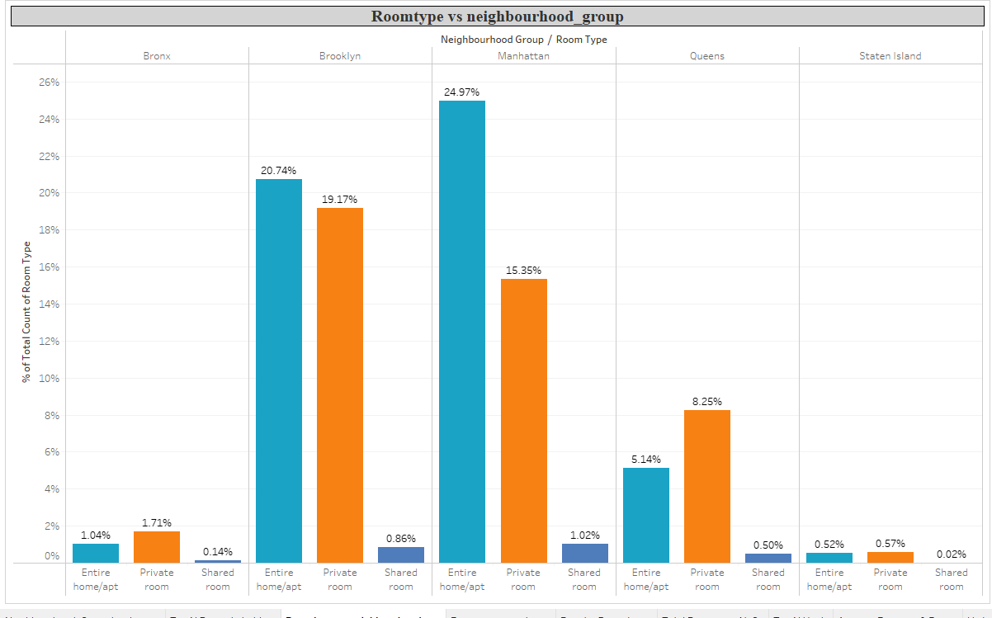
Regarding Room Type
Total Count of Room Type in each Neighbourhood_Group :- Manhattan has more listed properties with Entire home/apt around 24.97% of total listed properties followed by Brooklyn with around 20.74%.
Very few of the total listed have shared rooms listed on Airbnb where there’s negligible or almost very rare shared rooms in Staten Island and Bronx.

Slide 16
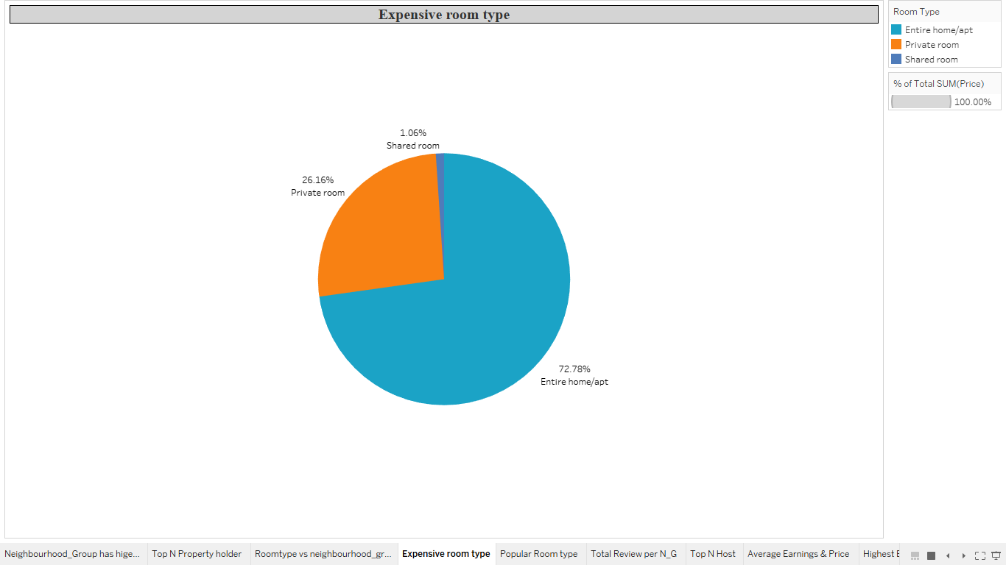
Most Expensive Room type :- The Chart shows distribution of expensive room type, its showing Entire home/Apt is most expensive Room type

Slide 17
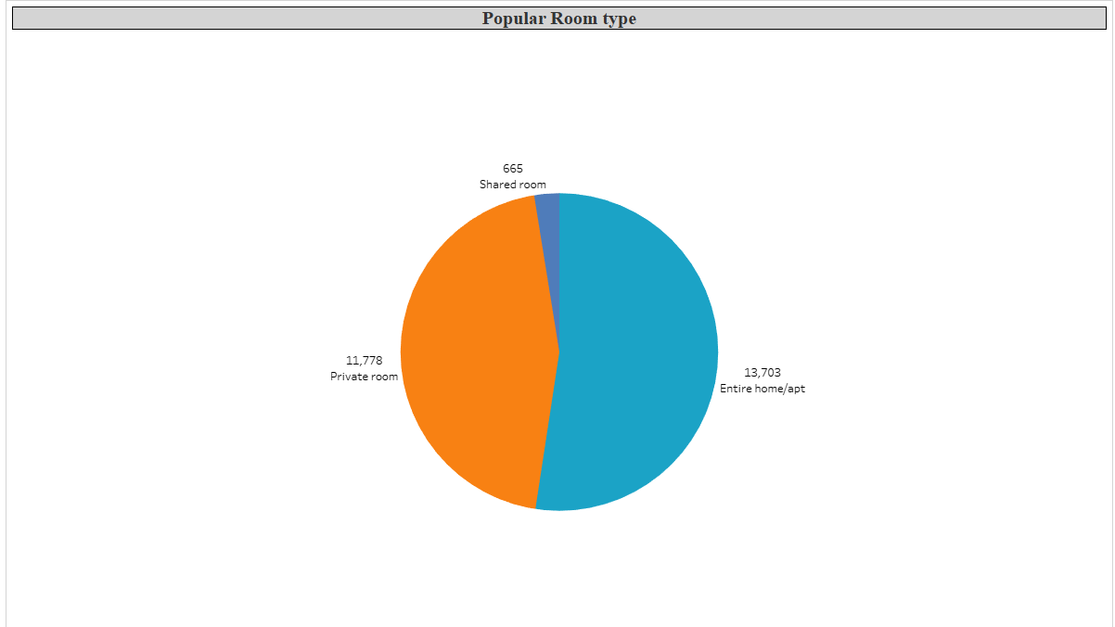
Most Popular Room Type :- In New York City Customer can book Entire home/Apt for most night

Slide 18
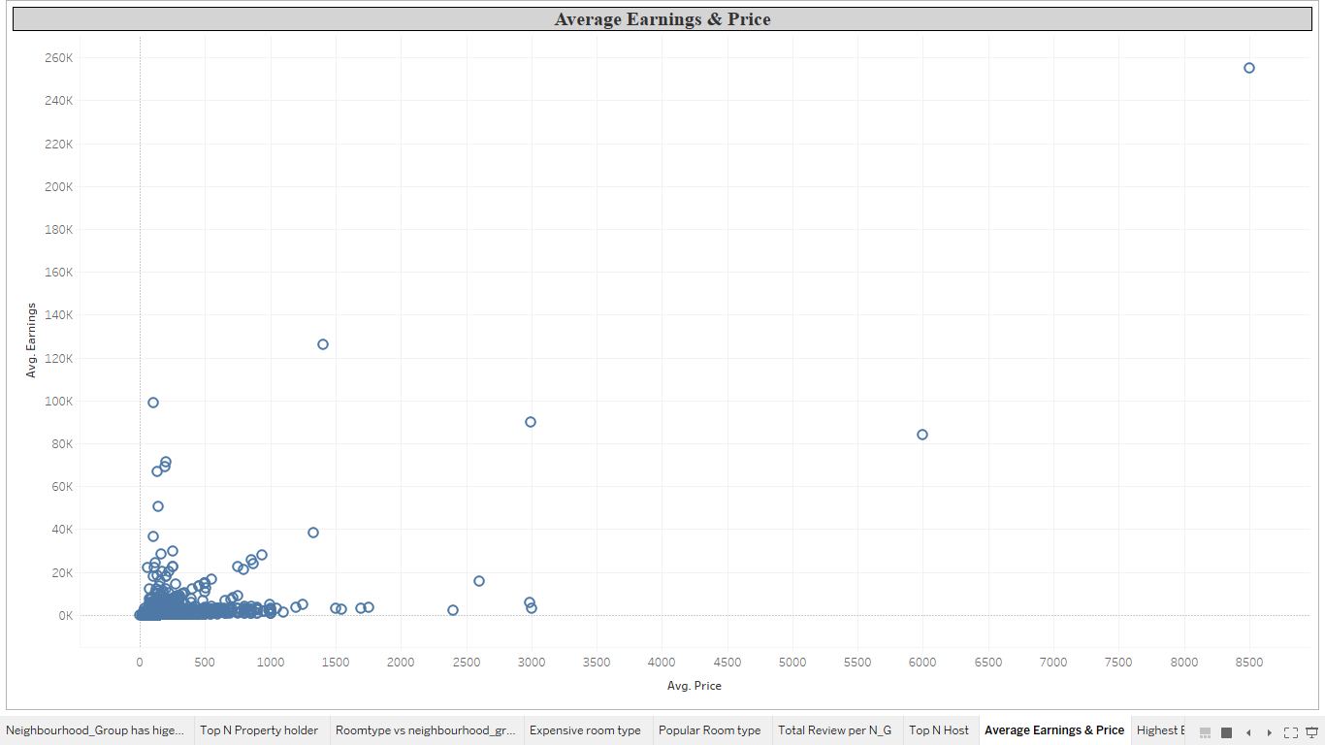
Regarding Price and Earning
What is relation between Price and Earning :- In this Chart we can see that the Avg Earning is in between 10$ to 40k$ when the Avg price of the property is between 10$ to 1k$

Slide 19
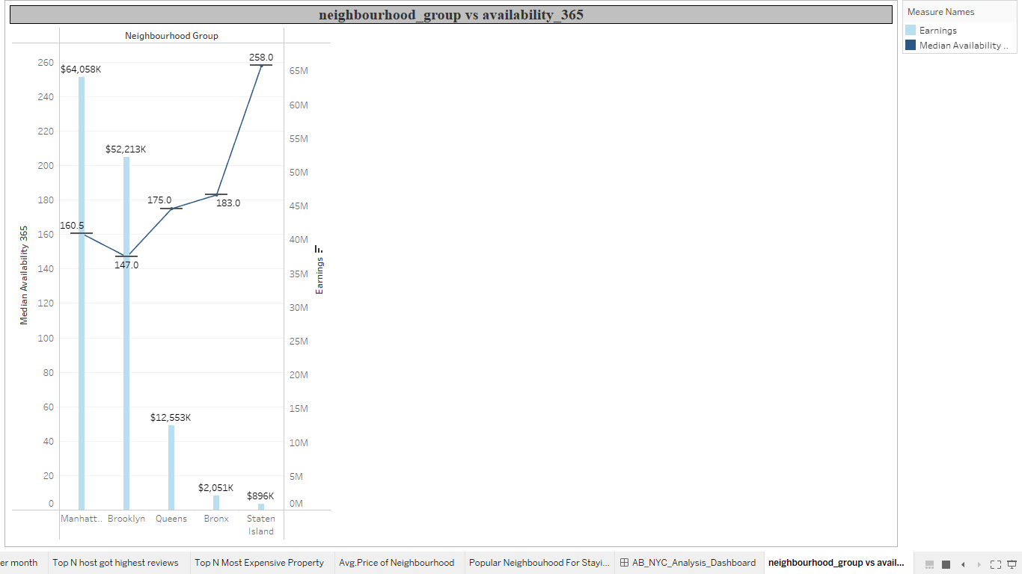
In Manhattan And Brooklyn the average availability is 160 & 147 rep. and the earning is $64K and $52K respectively. So here we can infer that the average availability in Manhattan & Brooklyn is less but the earning is high but in other three Neighbourhood Group availability is higher but the earning is less

Slide 20
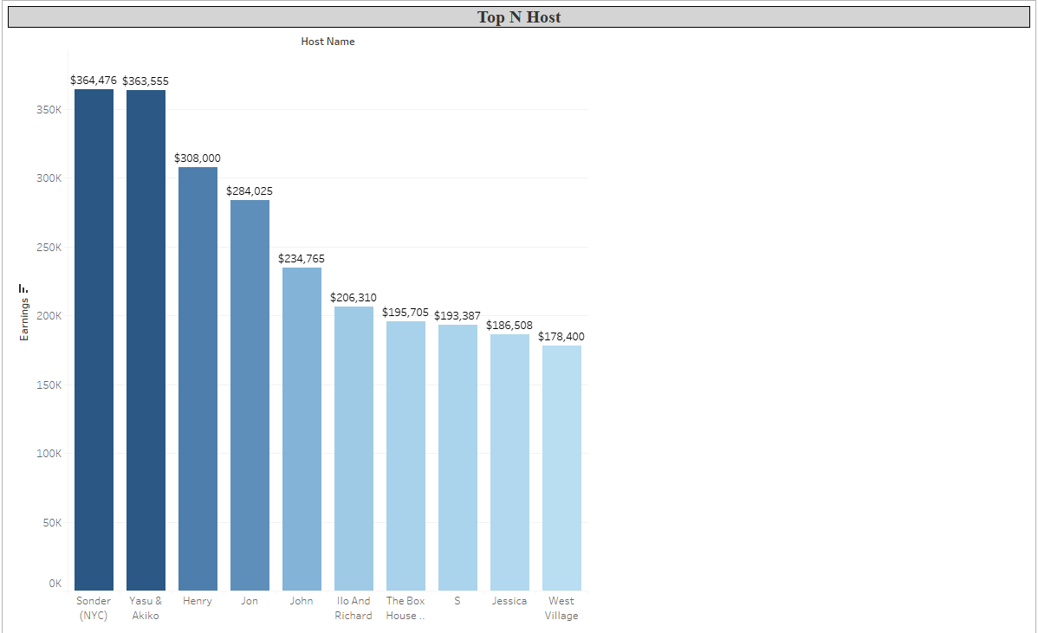
Top 10 Host who has most Earning :- As per the above graph we can infer that Sonder and Yessu & akiko has highest earning

Slide 21
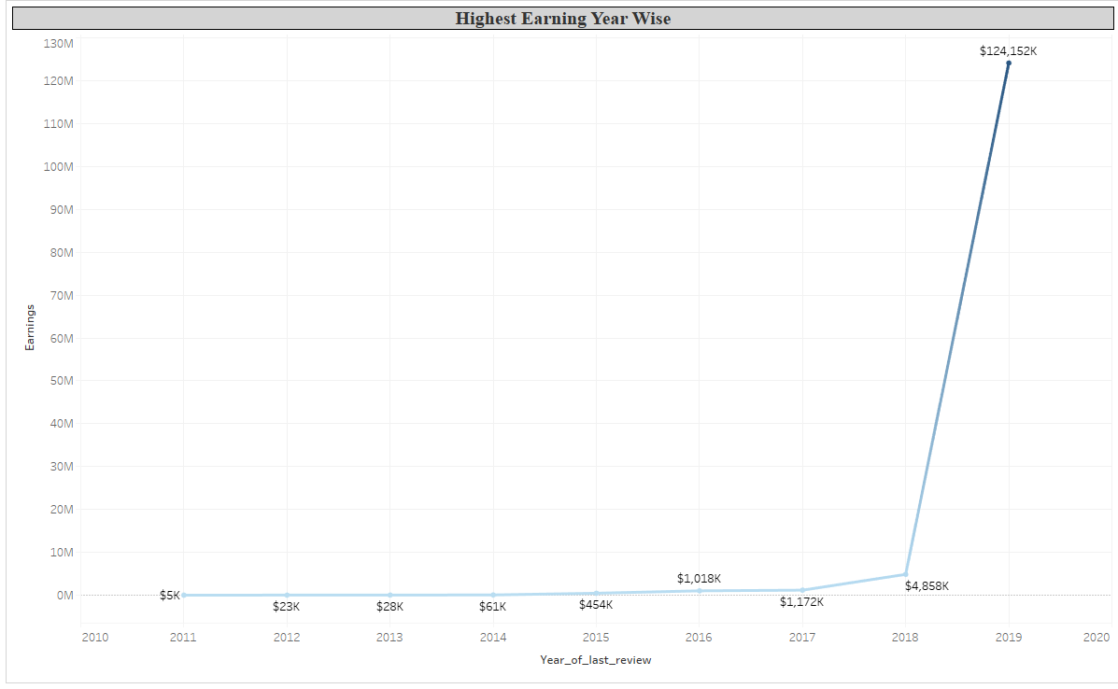
Which Year has Highest Earning :- From this line chart we can see that the Year 2019 has the highest earning

Slide 22
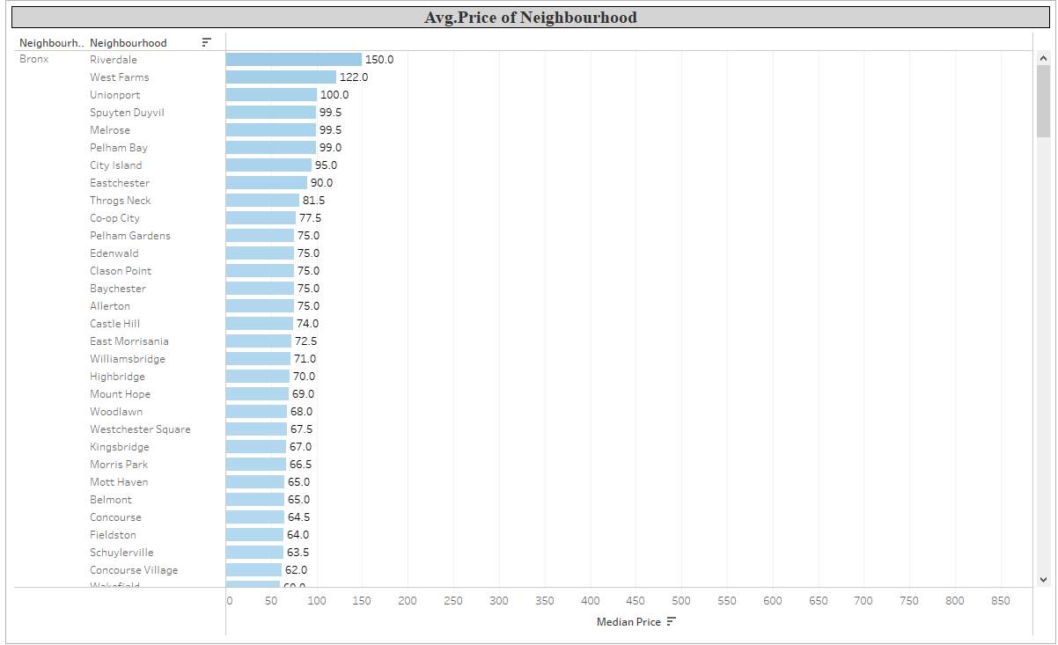
Avg.Price of Neighbourhood :- So from this chart we can see that what should be the avg. price of the Neighbourhood_groups in the each Neighbourhood

Slide 23
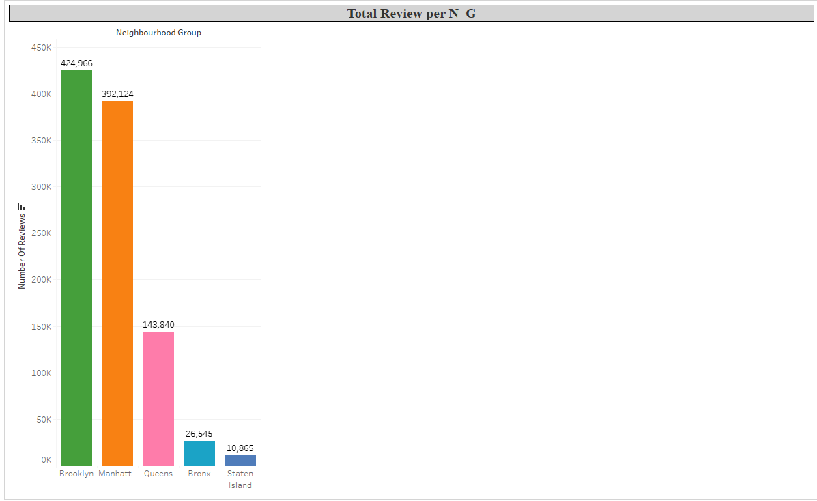
Total Reviews per Neighbourhood_Group :- From this graph we can infer that, the Brookln has the highest number of reviews and the staten island has the lowest number of reviews

Slide 24
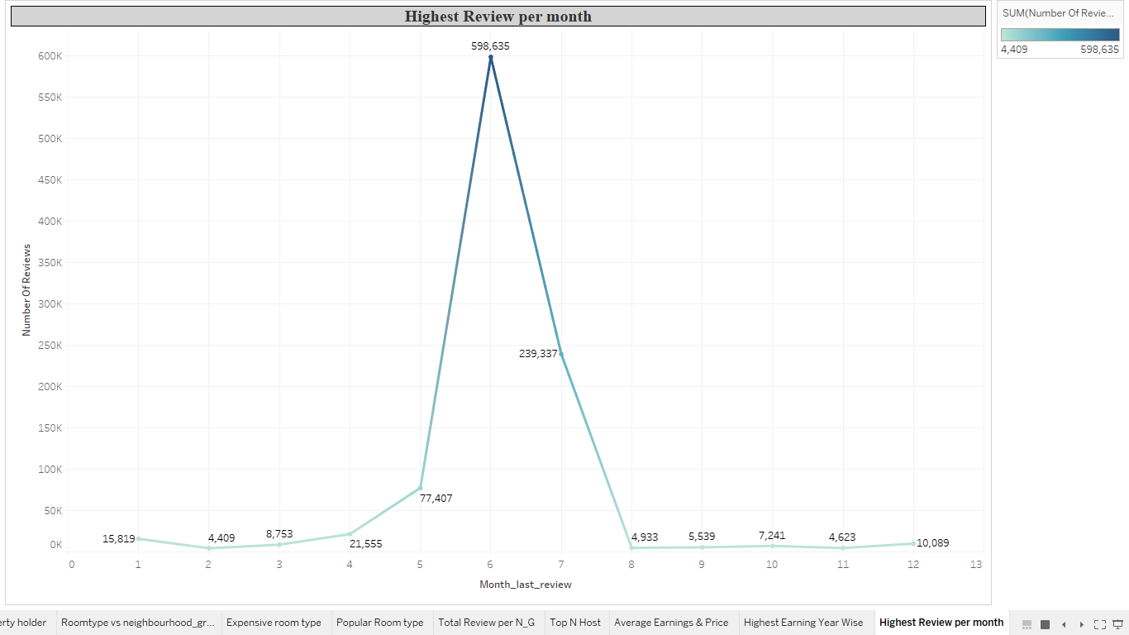
Highest Reviews Month Wise :- From the above line chart we can see that, 6th month has the highest review and from the 4th month the reviews are increasing and it goes high in 6th month and again it starts decreasing

Slide 25
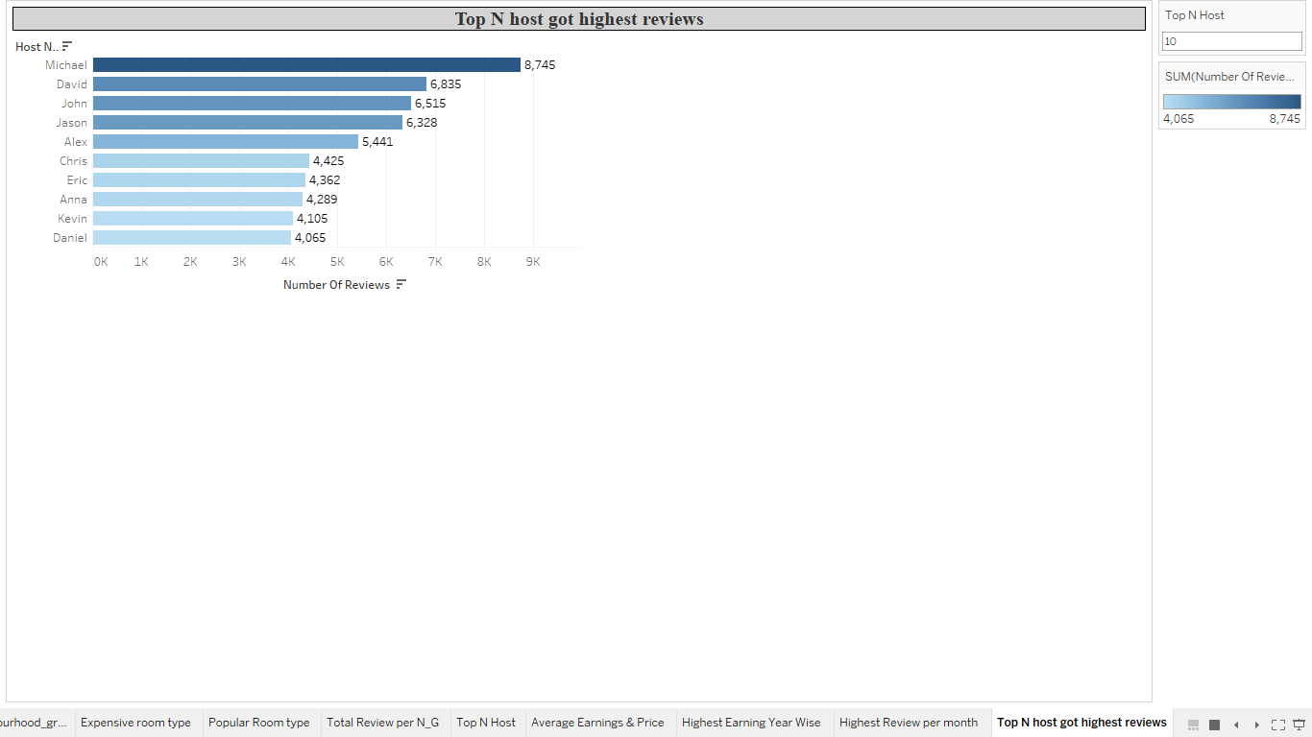
Top N host name who got highest reviews :- From this chart, we can see that, the Michale has got the highest review from all the other hosts which are out there

